Slide 1
Perspectives in CS-Studio

Slide 2
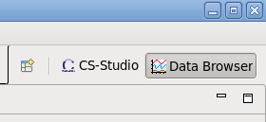
Basics
A perspective is a layout of the views and editors inside CS-Studio
The menu in the top right tells you what perspective you’re in
You can move things around as you like
To get back to the original set-up, right-click on the perspective and select ‘Reset’
If you have two main windows, they can be in different perspectives
Notes:
NSLS2

Slide 3
Saving Perspectives
Right-click on the perspective and select ‘Save As…’
It’s best to save your perspective under a new name
Now when you reset, it will go back to the saved state
Perspectives are saved in the workspace by default
When you restart in the same workspace, your perspective will still be available
Notes:
NSLS2

Slide 4
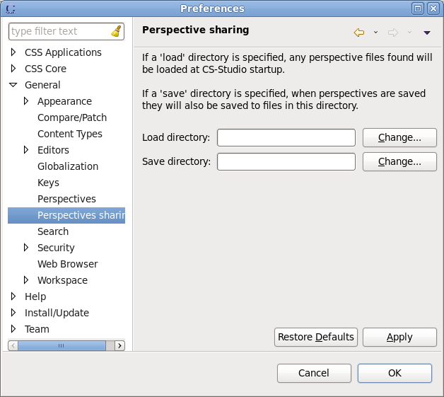
Sharing Perspectives (CS-Studio 4.3)
Edit | Preferences | General | Perspectives Sharing
Add a ‘Save directory’ and when you save a perspective, it will be saved to file here
Add a ‘Load directory’ and when you startup, it will load perspectives from the files in here
They can point to the same location!
Notes:
NSLS2

Slide 5
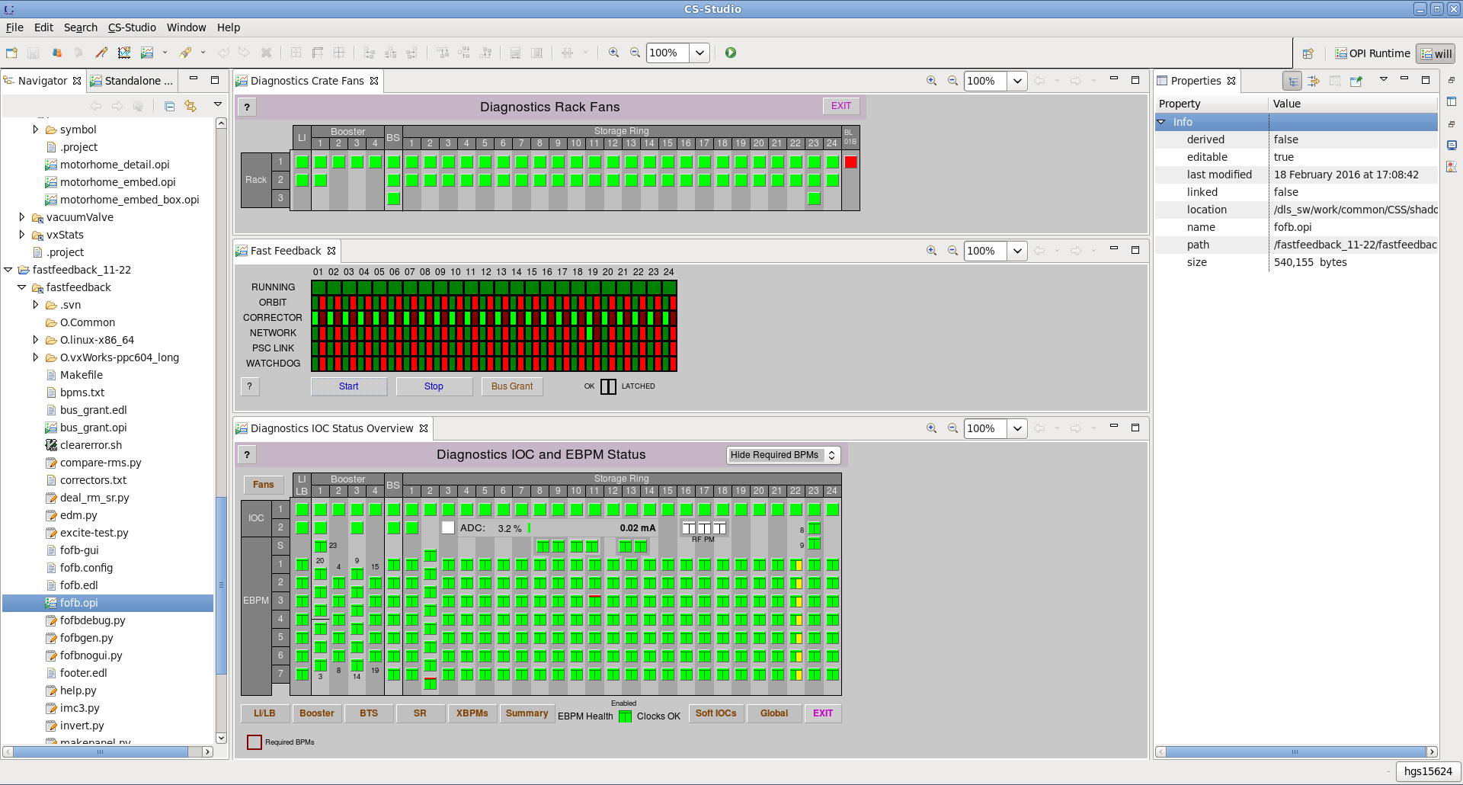
Sharing Perspectives
You can save a perspective with OPI files in the workbench
If you share it, the other workspaces need the same OPI files
Notes:
NSLS2

Slide 6
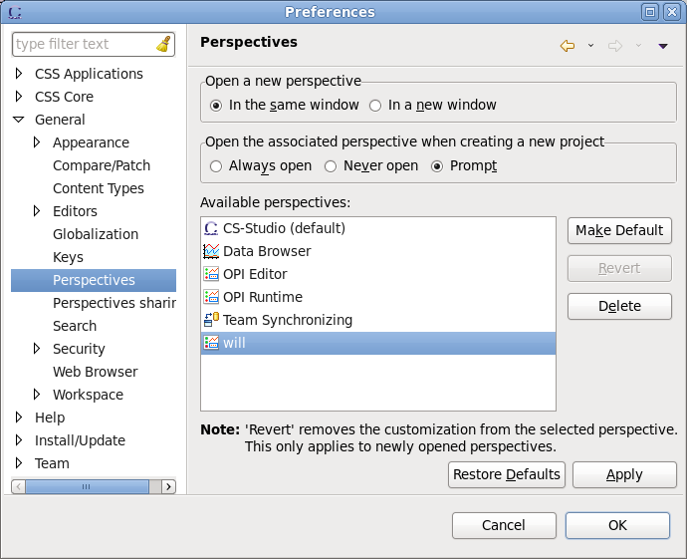
Deleting Perspectives
Edit | Preferences | General | Perspectives
You can delete the perspectives you have saved or imported
You can’t delete the ones installed in CS-Studio
Notes:
NSLS2

